Slide 1


INFLIBNET Centre
Major Activities & Services
Abhishek Kumar
INFLIBNET Centre
Gandhinagar, Gujarat

Slide 2

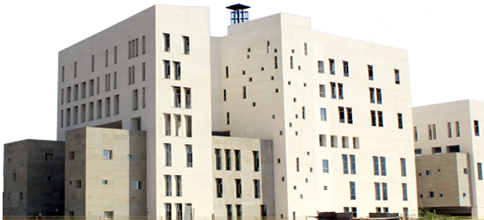
Established in 1991
Recognized as
an Inter-University Centre of the UGC in 1996.

Slide 3


Major Activities and Services (10 Verticals )
Library Automation (2)
Access to Scholarly Resources (3)
Open Access Initiatives (5)
Scholarly Network (4)
e-Learning (4)
LIS & ICT Skill Development
e-Governance @ UGC
Accreditation & Ranking (3)
MoE Funded projects (4)
Other Academic Projects (AIU, TG Portal, e-Gov @ Universities etc)

Slide 4
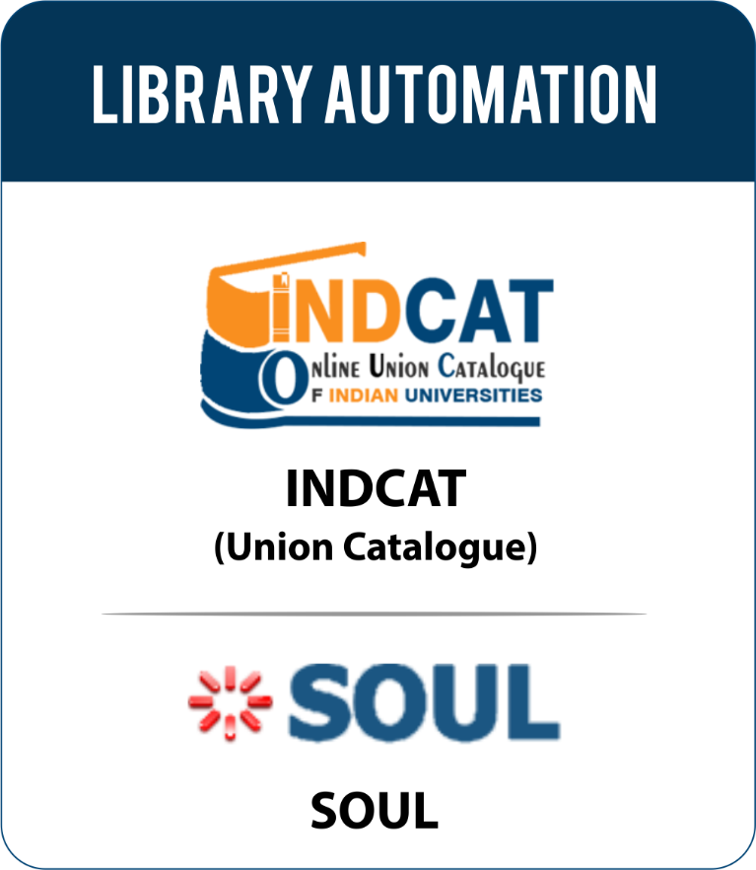
IndCat
  Online catalogues of Books, Theses and Journals available in major university libraries in India. More than 2.30 crore bibliographic record of books from more than 240 universities.
SOUL
  State-of-the-art Integrated Library Management System for library automation. 4200+ installation.
  SOUL 3.0 Launched (Feb, 2021) by Hon’ble Chairman, UGC

Slide 5

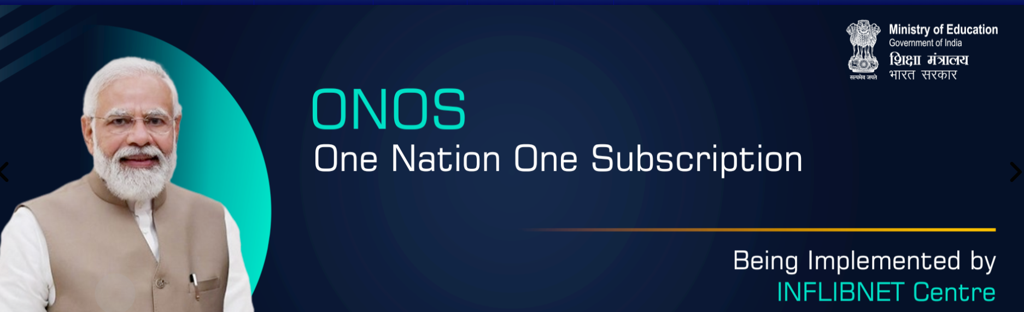
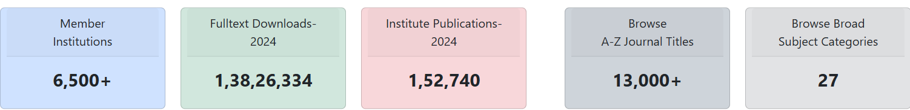
PM-One Nation One Subscription

Slide 6


Background
UGC-INFONET Digital Library Consortium (December 2003)
Launched by
Dr APJ Abdul Kalam
Former President of India
  Funded by the MoE
  Access of e-Resources to CFTIs
UGC-INFONET Connetivity Programme (December 2002) Innagurated by
Shri Atal Bihari Vajpayee
Former Prime Minister of India
2004
INDEST-AICTE
  Funded by the UGC (2004 – 2015)
  Access of e-Resources to Universities
2003
UGC-INFONET
2010
NLIST
  Funded by NMEICT 2010-13 & by UGC 2014-15
  Access of e-Resources to Colleges
2016
E-ShodhSindhu
Notes:
INDEST-AICTE (2004)
NLIST
(2010)
E-Shodh Sindhu (2016)

Slide 7
Background
eShodh Sindhu
DRDO
CeRA
ERMED
MCIT
NLIST
DeLCON
DAE
NKRC
All Other Govt. Colleges
Access to subscription journals were being acquired through different library consortia of government departments, academic and R & D institutions; and through individual subscriptions by various higher education and R & D institutions
E-Resource Consortium

Slide 8

Background
ONOS was first proposed in the country’s fifth draft National Science, Technology, and Innovation Policy (2020)
Approved by Union Cabinet on November 25, 2024
Implemented on January 1, 2025

Slide 9
One Nation One Subscription
Central Sector Scheme for Rs. 6000 Cr for three years (2025-27) National consortium for journal subscriptions
Subscription Journals
• Centrally negotiated and centrally funded national subscriptions for e-journals
• Access to every individual (who needs it) in the country
Article Processing Charges (APCs)
• Central fund (Rs. 150 Cr per year) for supporting APCs of selected good quality Open Access journals
• Discounts on APCs for Indian authors as far as possible

Slide 10
ONOS – Implementation
Phased implementation
i. Phase-1 (3 years) – Merge all library consortia and bring in more institutions
ii. Phase-II – include Private academic institutions through a public-private partnership model
iii. Phase-III – universal access – designated access points at public libraries

Slide 11
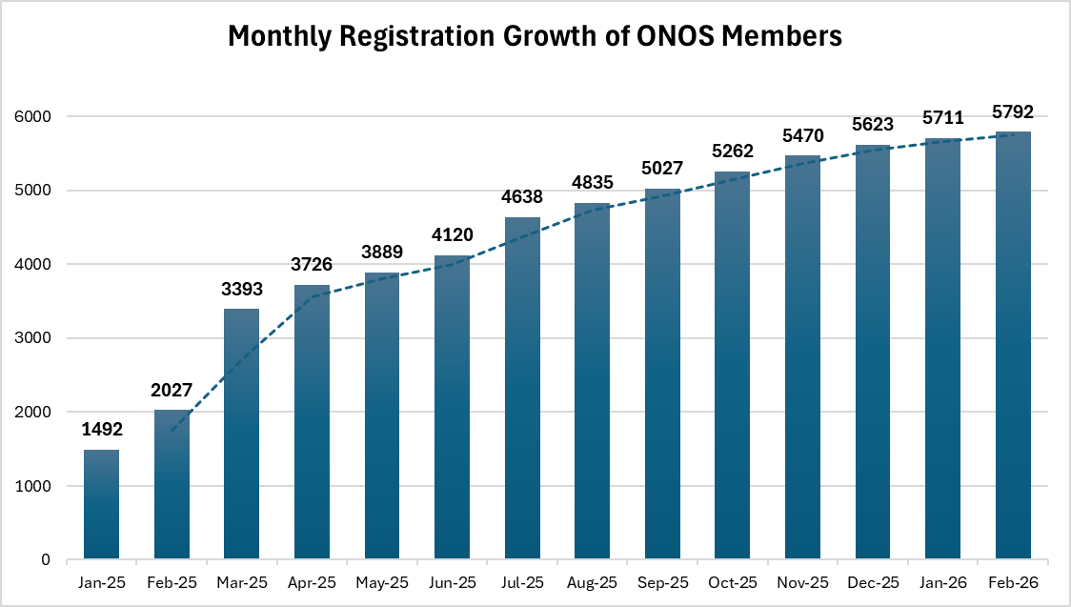
ONOS Registered Institutions Growth
Expected to Reach Targeted 6500 Institutions in next 3-4 months

Slide 12
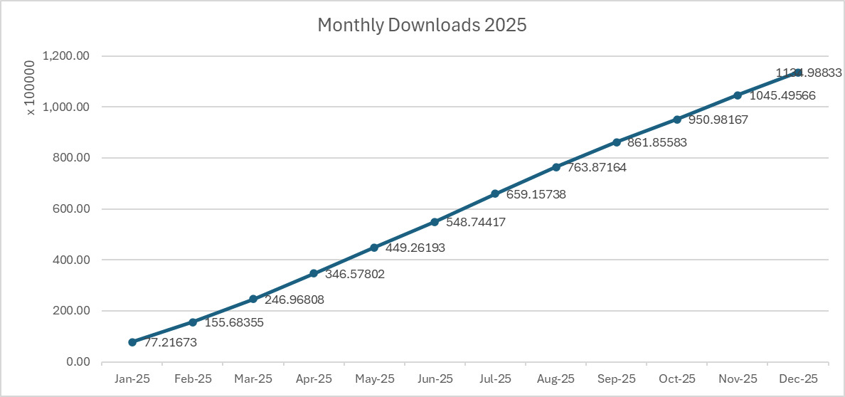
Downloads by member institutions

Slide 13
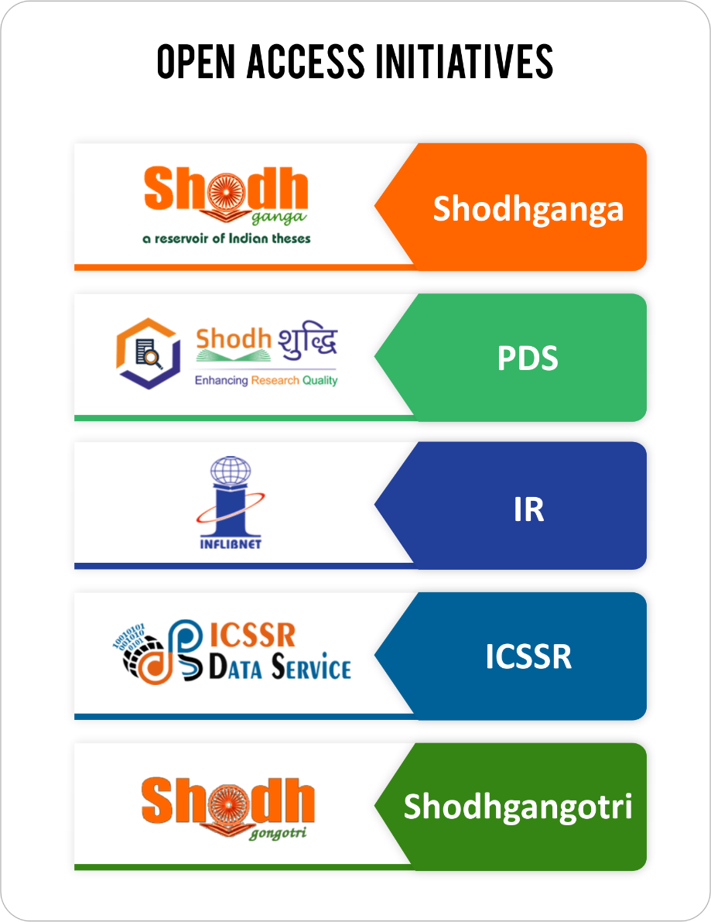


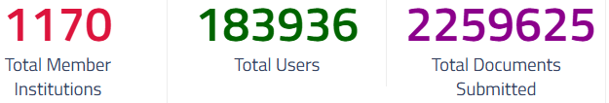

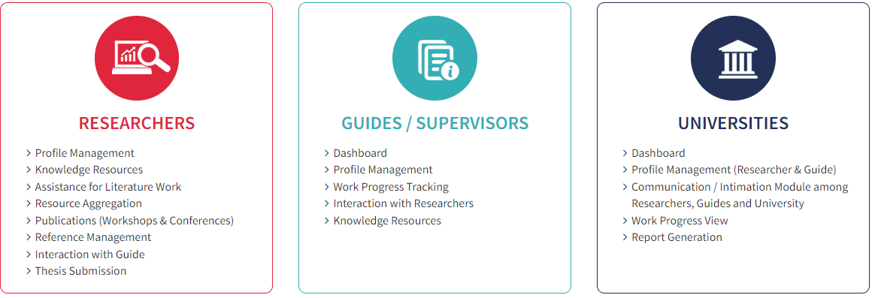
Open access of Full-text thesis ( 6,60,000+)

Slide 14


A Gateway to Researchers for resources

Slide 15
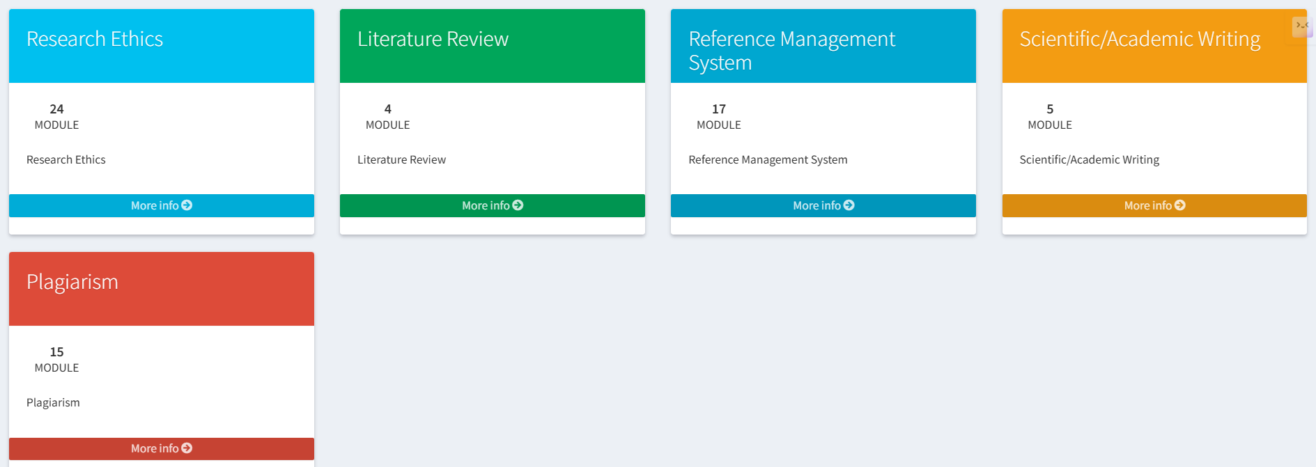



Knowledge Resources
(How to do PhD)
Review of Literature
Chapters Writing (Scholarly Content)
Publications
Reference Management
Interaction with Guide
RDC/ DRC/RAC
(Committee)
RESEARCHER

Slide 16
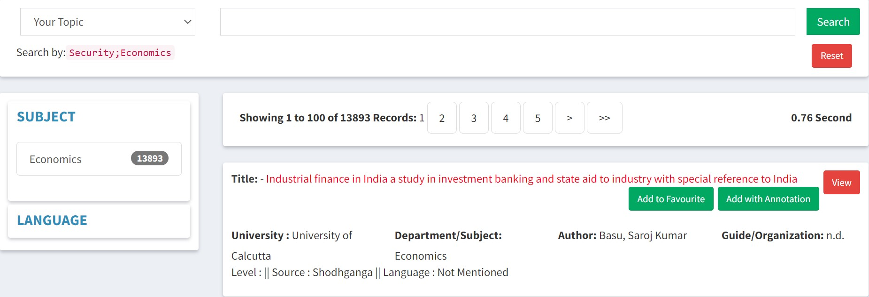

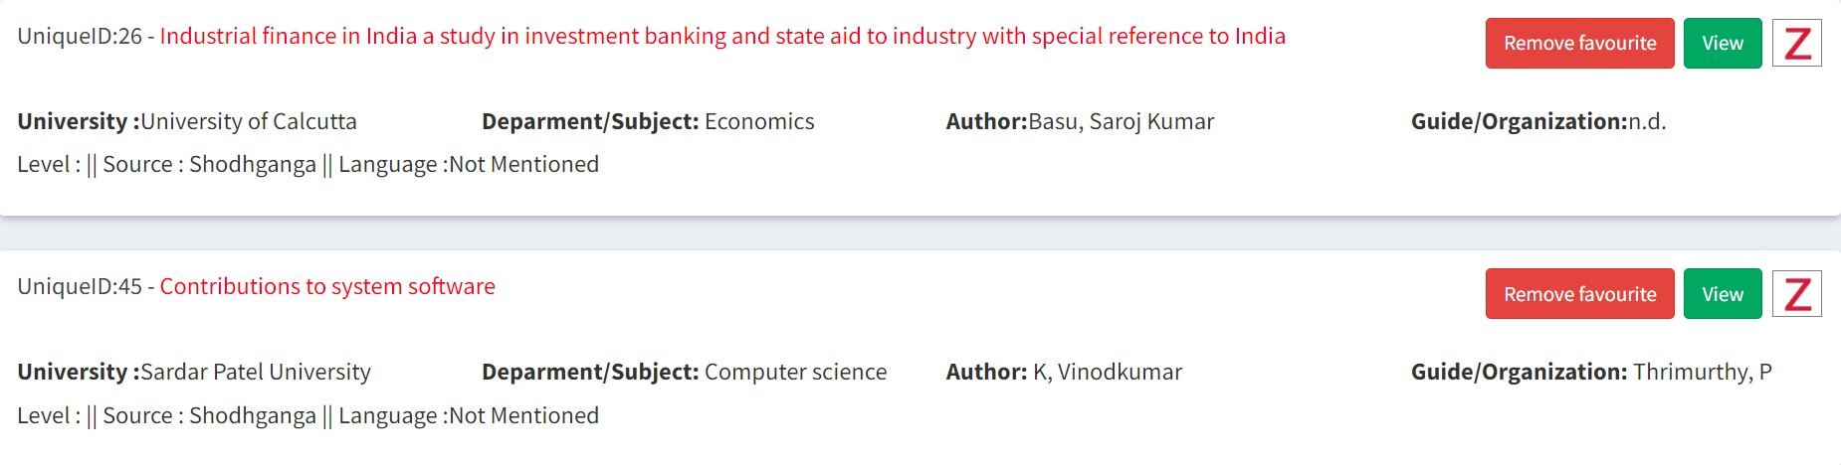
Knowledge Resources
(How to do PhD)
Review of Literature
Chapters Writing (Scholarly Content)
Publications
Reference Management
Interaction with Guide
RDC/ DRC/RAC
(Committee)
6.15 Lakhs Thesis
My Favourite
RESEARCHER

Slide 17

Knowledge Resources
(How to do PhD)
Review of Literature
Chapters Writing (Scholarly Content)
Publications
Reference Management
Interaction with Guide
RDC/ DRC/RAC
(Committee)
My Favourite
Dept. Publications
Google Scholar
Search (Open Sources)
IRINS
Zotero
RESEARCHER

Slide 18

Knowledge Resources
(How to do PhD)
Review of Literature
Chapters Writing (Scholarly Content)
Publications
Reference Management
Interaction with Guide
RDC/ DRC/RAC
(Committee)
My Favourite Journal
Workshops / Conferences
Add Your Publication/Workshop/Conferences
Journals
RESEARCHER

Slide 19






Knowledge Resources
(How to do PhD)
Review of Literature
Chapters Writing (Scholarly Content)
Publications
Reference Management
Interaction with Guide
RDC/ DRC/RAC
(Committee)
RESEARCHER

Slide 20
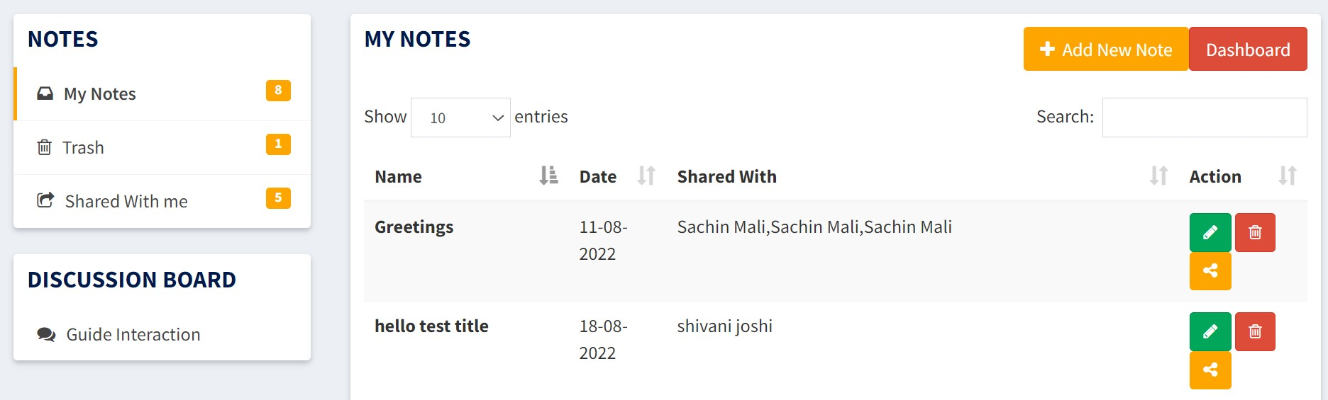
Knowledge Resources
(How to do PhD)
Review of Literature
Chapters Writing (Scholarly Content)
Publications
Reference Management
Interaction with Guide
RDC/ DRC/RAC
(Committee)
RESEARCHER

Slide 21
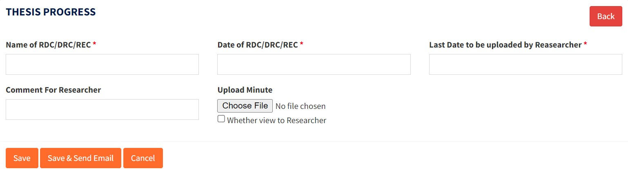
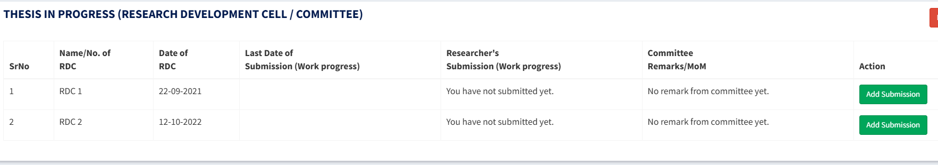
Knowledge Resources
(How to do PhD)
Review of Literature
Chapters Writing (Scholarly Content)
Publications
Reference Management
Interaction with Guide
RDC/ DRC/RAC
(Committee)
Researcher
RESEARCHER

Slide 22
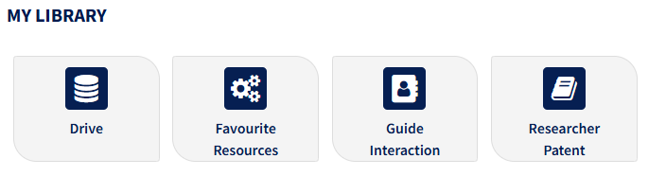
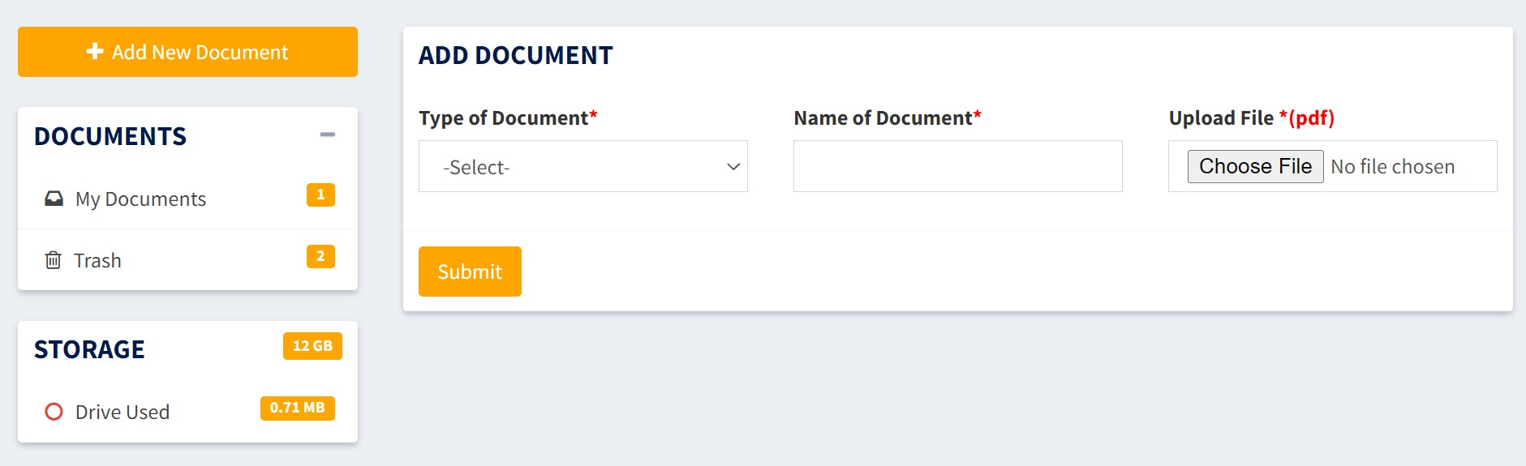
MY LIBRARY - Drive
MY LIBRARY
Drive
Notes:
Researcher will able to use his/her own Drive under My Library tab for storing documents on Thesis work

Slide 23
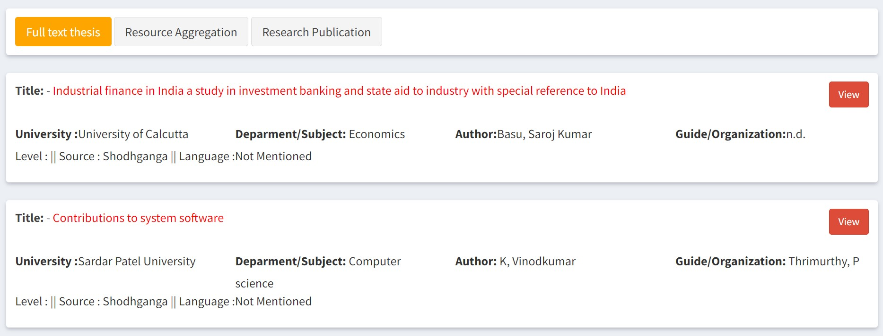
MY LIBRARY - Resources
MY LIBRARY
Drive
Notes:
Researcher will able to use his/her own Drive under My Library tab for storing documents on Thesis work

Slide 24
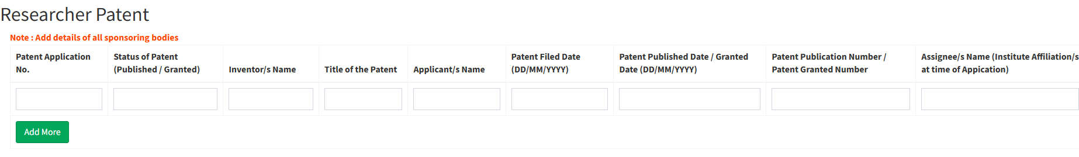
MY LIBRARY – Guide Interaction
MY LIBRARY
Guide Interaction
Notes:
Researcher can Interact with the Guide using Guide Interaction option where he/she can Add Notes and Share with Guide
A Discussion Board is also given for making Creative Discussion

Slide 25
Life Cycle of Researcher
01
02
033
04
Self register/By University
Verification by University
Log in to the portal
Access of resources to researchers(portal)
05
06
07
Interaction with Guide
RDC details
Thesis submission

Slide 26
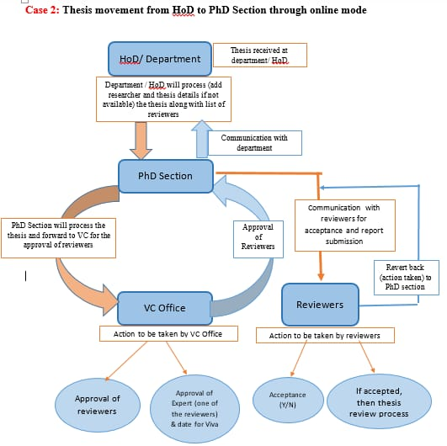

Slide 27
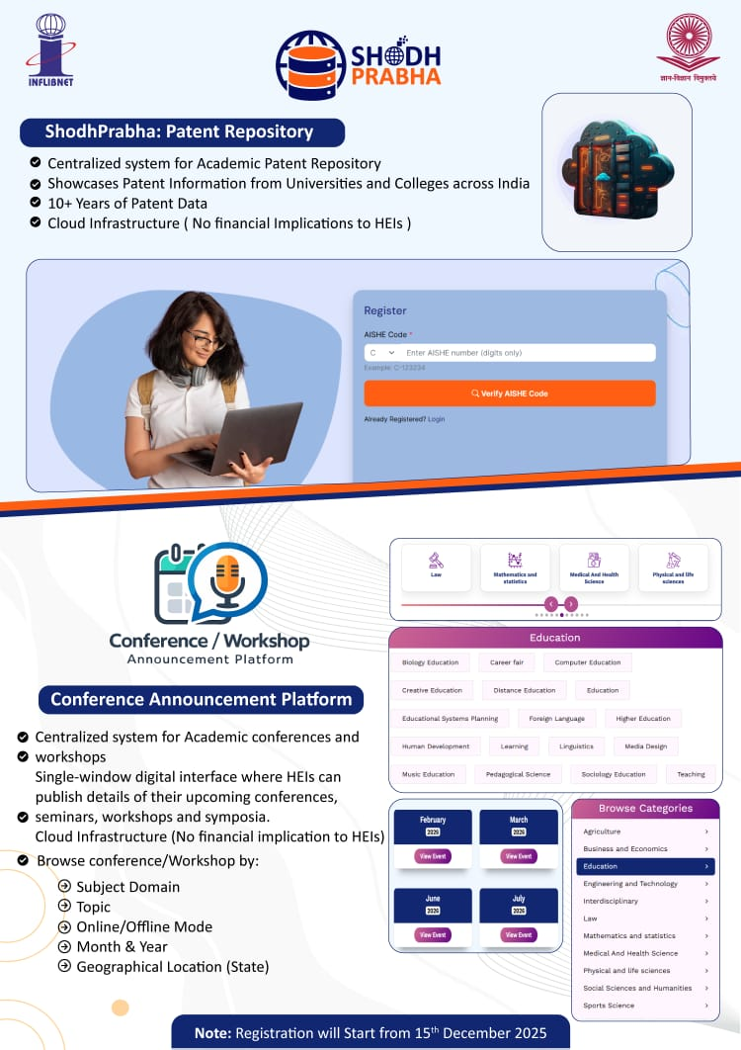

Slide 28




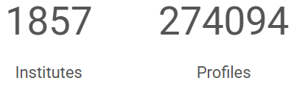
VIDWAN is the premier database of profiles of scientists / researchers and other faculty members.
IRINS is web-based Research Information Management (RIM) service provided by the INFLIBNET.

Slide 29
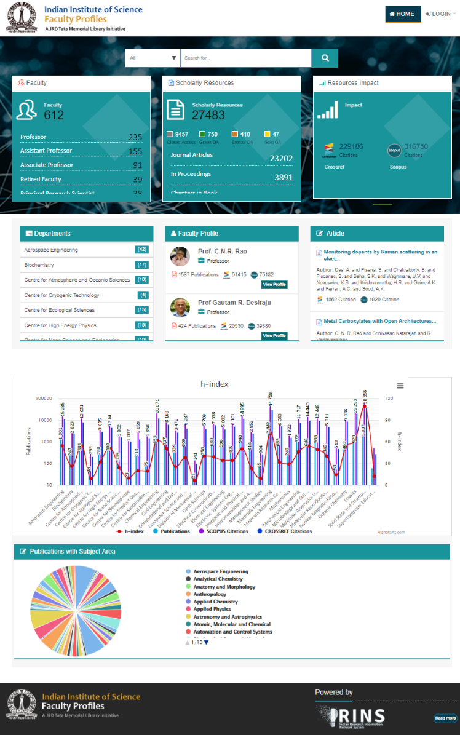
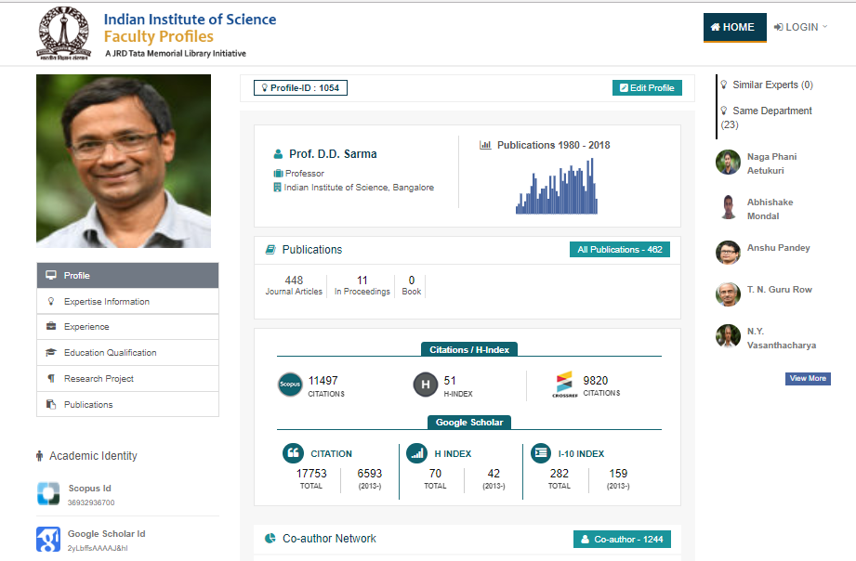




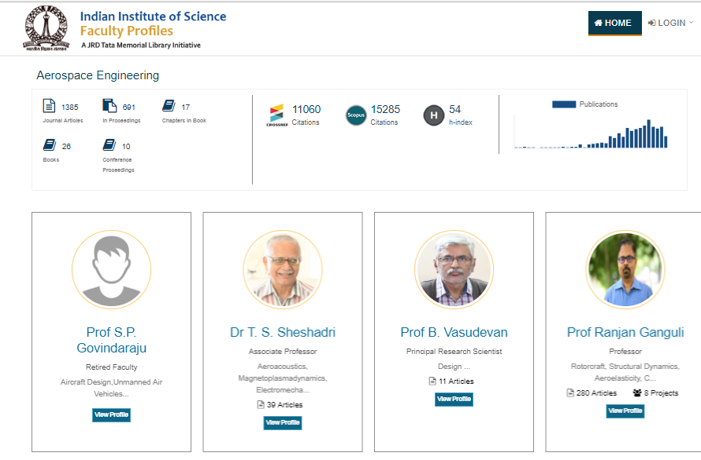



Faculty
Profiles
Department
Profiles
(Aerospace
Engineering)
IRINS @ Institute level
IRINS at Institute level
Institute
Profile

Slide 30

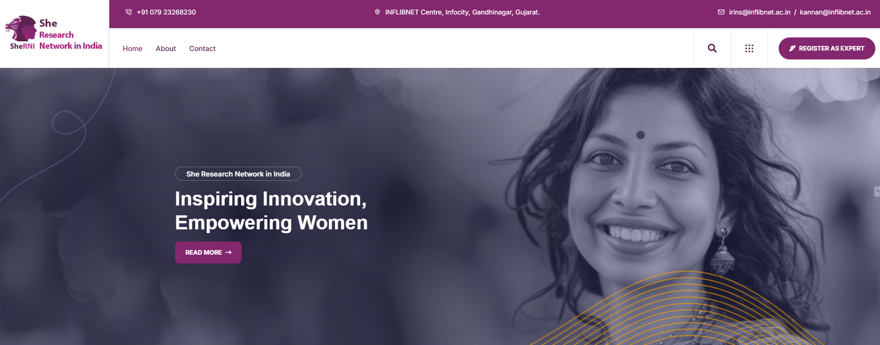
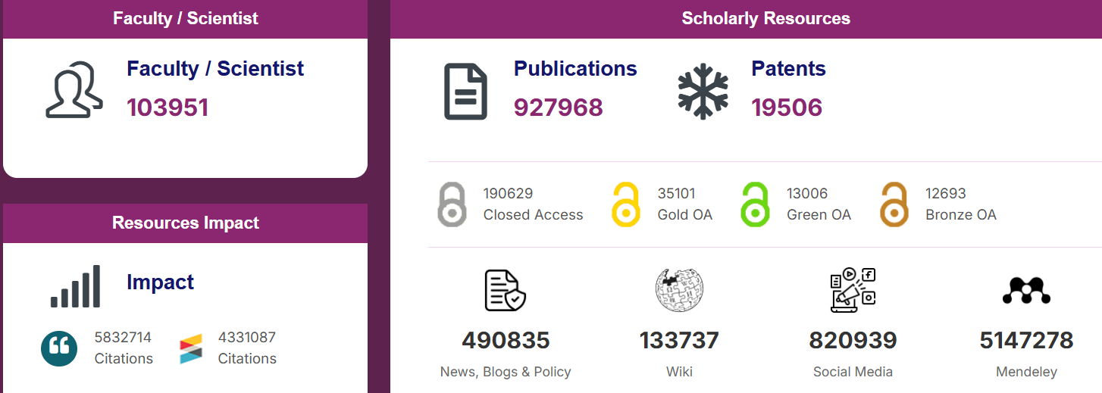
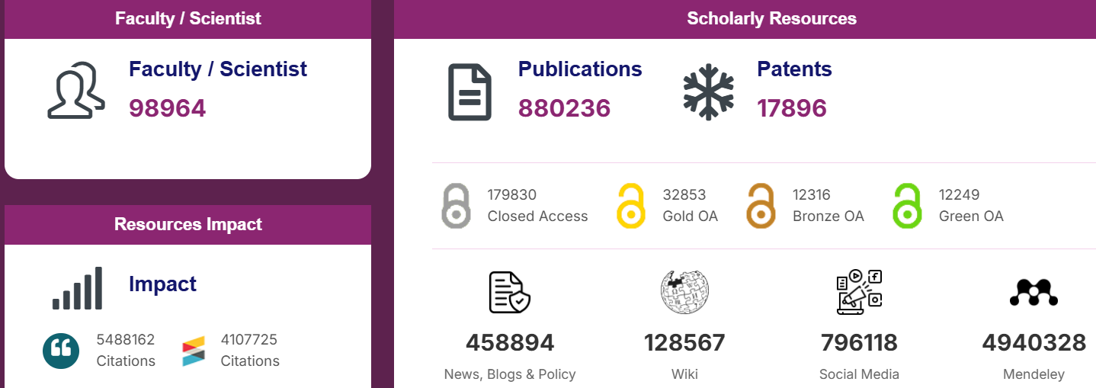
International Womens’ Day: Highlights of Indian Women achievers and leaders in various domains
Gujarat: 2523

Slide 31





E-Learning: Largest Open Educational Resources
SWAYAM
Technical Coordination with UGC / CEC
Offering Courses (Research Ethics)
Archival of UG-PG courses (Non-tech)
Vidya-Mitra
Best OER 2018 Global Award
e-PG Pathshala
SWAYAM Prabha
e-Learning

Slide 32

ePG Pathshala: E-Content for Post Graduate Level Subject
Subjects: 70
E-text
23,000+
Video
23,000+
Subject Experts
5,100+
No. of Papers / Courses
710+

Slide 33
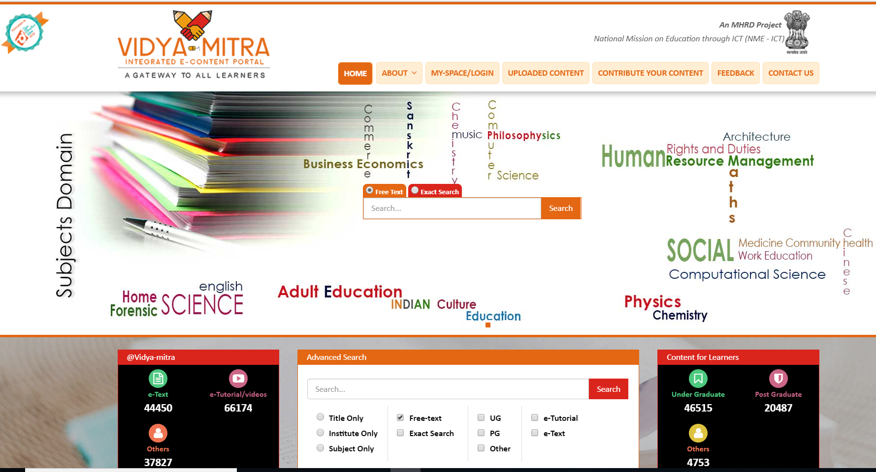

E-text: 44,450
Video: 66,174
Others: 37,827
Mobile App

Slide 34
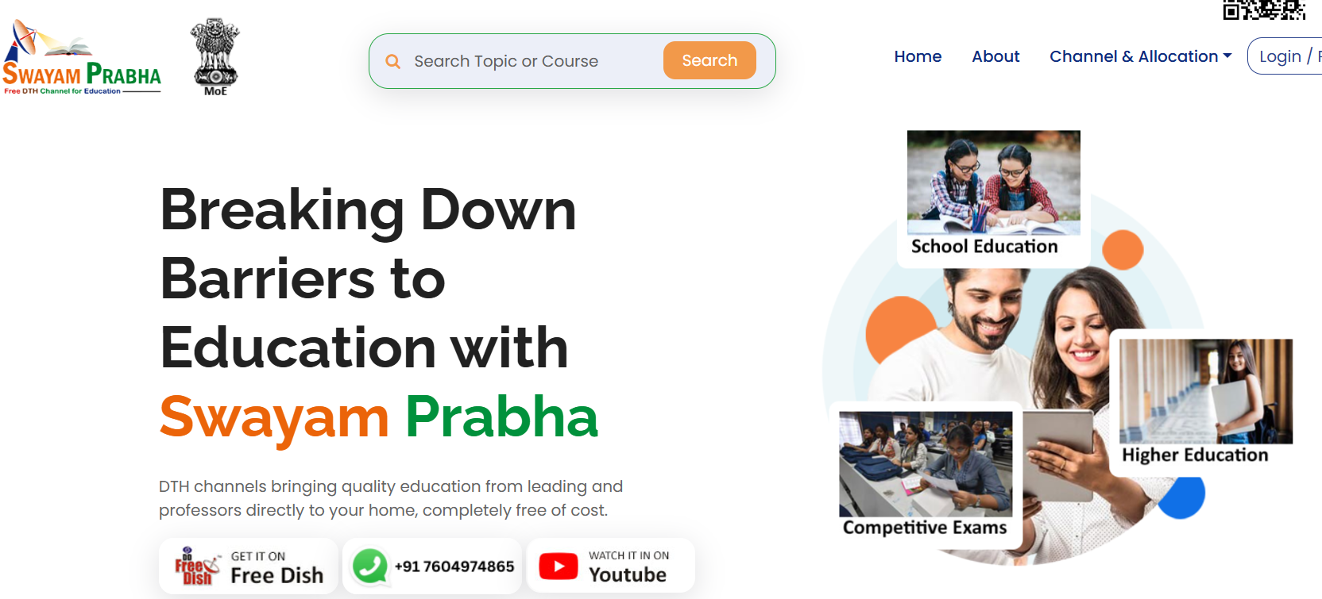
Role & Responsibilities
40 DTH channels
Web portal for Archival of tutorial
Program schedule
API for program schedule
Mobile-App / Integration with UMANG
Portal
Hosting of Video content

Slide 35

INFLIBNET @ Swayam-Prabha: National Coordinator
Academic Spiritual Content
ProjectSelf Bharat
Bhasha Dhara
Gujarat Vidyapith
Gap Areas / Campus to Corporate
Job readiness of students
Other PPP model
IRINS based platform to bring together corporates and academics
INFLIBNET is already technical partner for Swayam-Prabha since its inception.

Slide 37
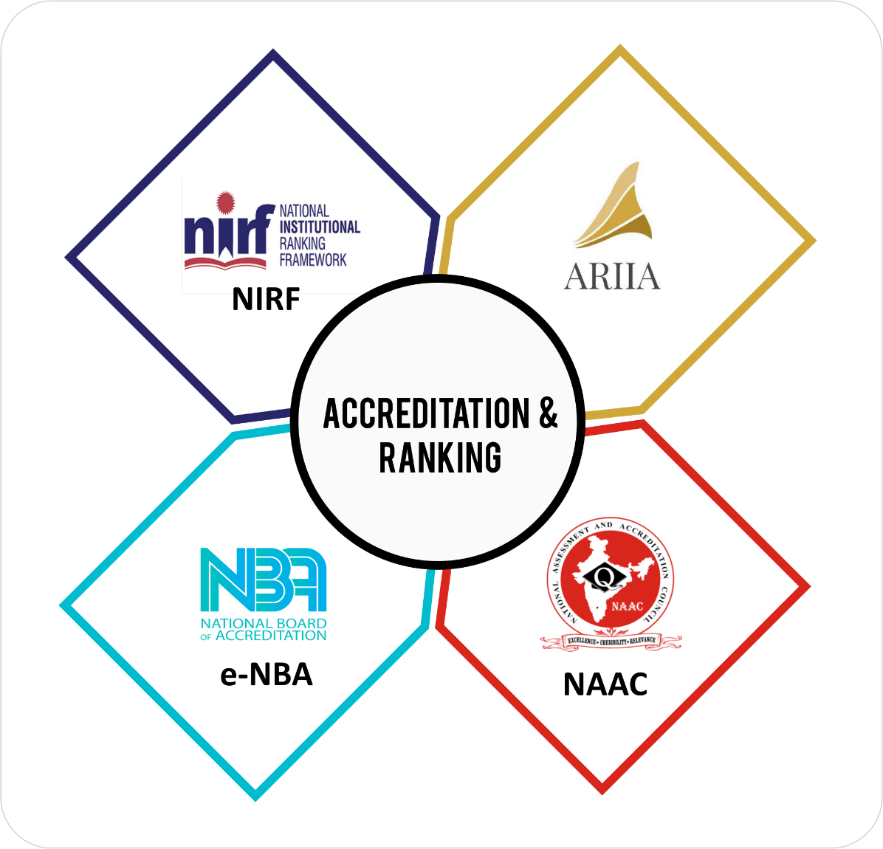
Ranking & Accreditation
Web applications
  Registration
  Data capturing System
  Feedback
Ranking Module
Technical Helpdesk
Research output data
  Publications
  Citations
  Patents
ARIIA is now NIRF-Innovation

Slide 38
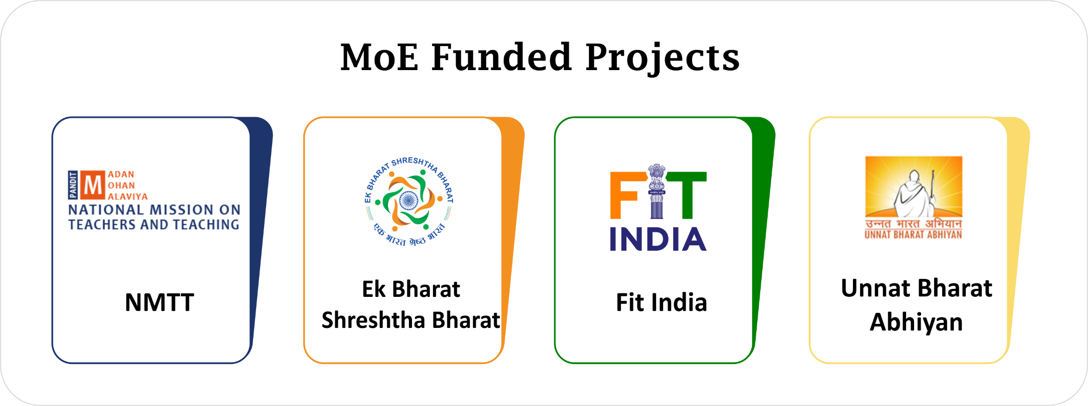

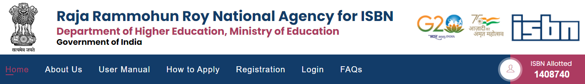

Slide 39
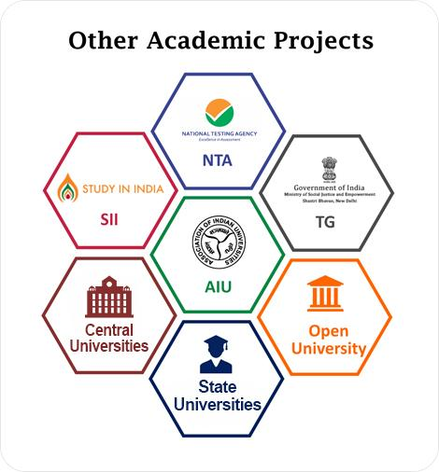

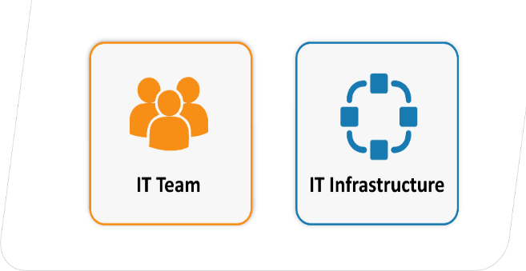
Automation / e-Governance
FHEI || DEB Portal || FRG Portal || CU Portal || DTBU || UAMP || e-Samadhan || IoE UTSAH|| Professor of Practice || HRDC || Recruitment || Commission Meetings || e-Seva || MMC

Slide 40

SOUL Training: Provide software training.
IRTPLA: Collaboration with university training programme
User Awareness Programme: Shodhganga, ONOS, IRINS etc.
E-Learning Conventions (PLANNER, CALIBER): Conference once in two year. (30+) Open Day (27 Feb)
50+ Training / workshop per year

Slide 41

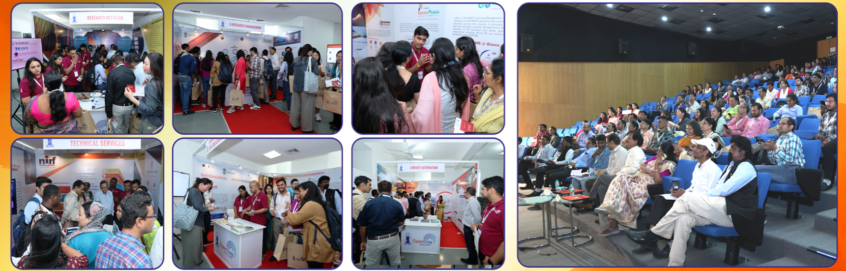
INFLIBNET Open Day

Slide 42

International Collaboration
G20: Knowledge Sharing Platform
MoU with US NIST (Washington DC) for multilingual and cross lingual applications, implementation for Hindi
COAR (Confederation of Open Access Repository): INFLIBNET as a Community of Practice (COP) Hub for Open Access Repositories

Slide 43

INFLIBNET towards its outreach

Slide 44
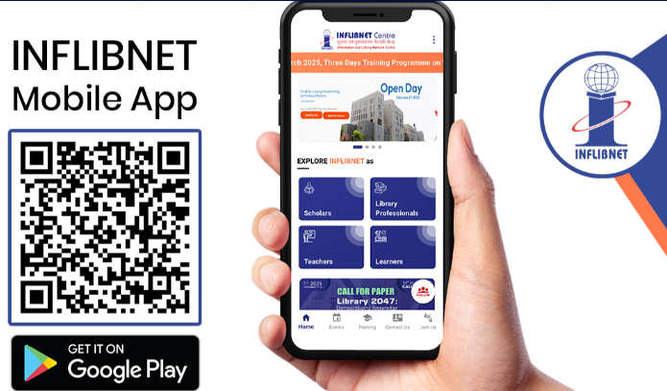

Slide 45
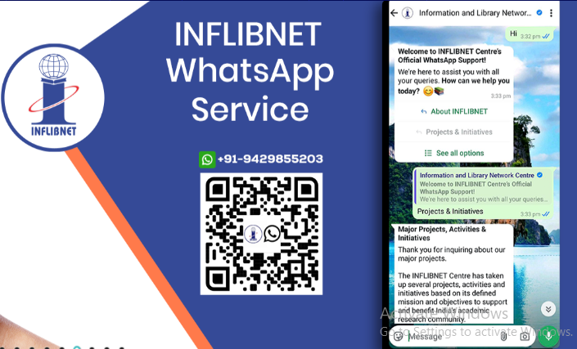

Slide 46







Subscribe Social Media Platforms

Slide 47
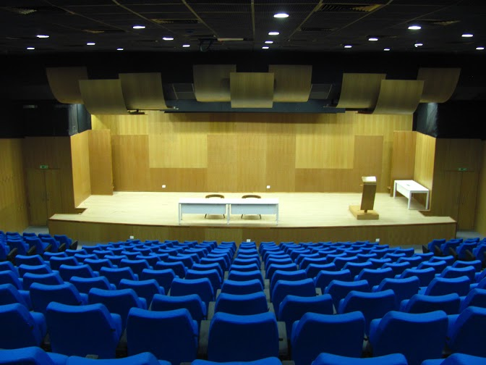
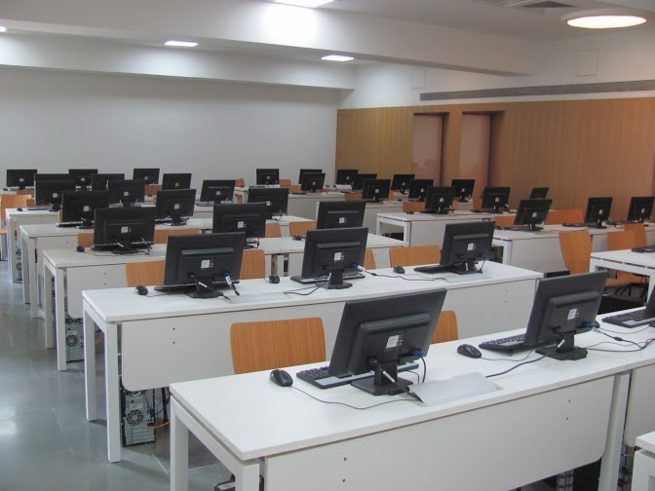
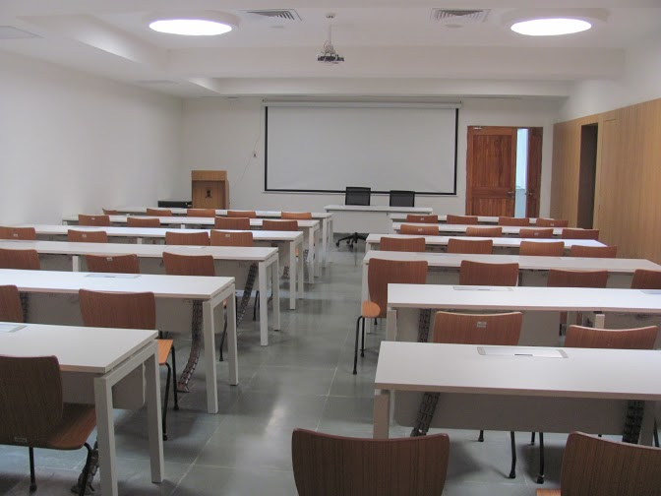
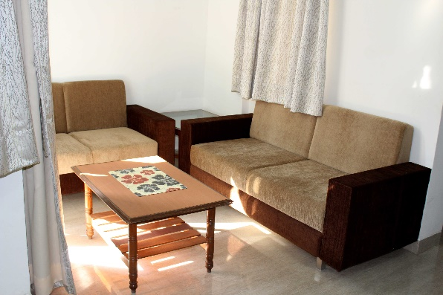
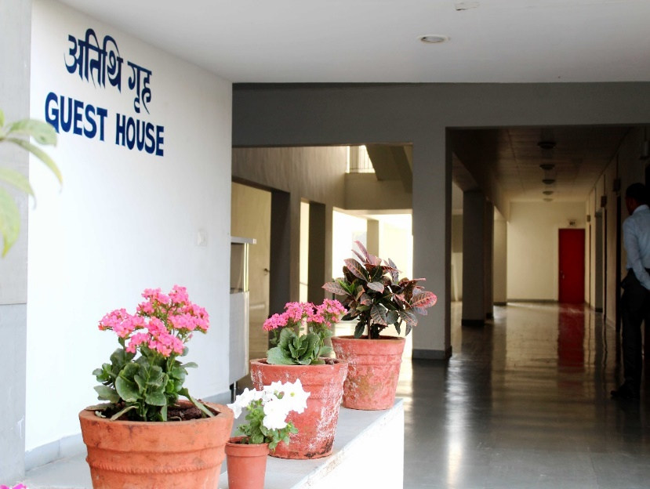
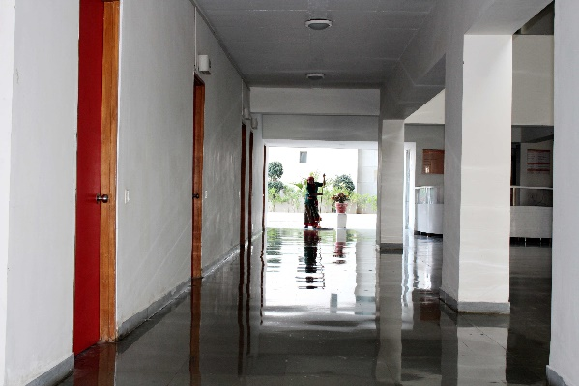
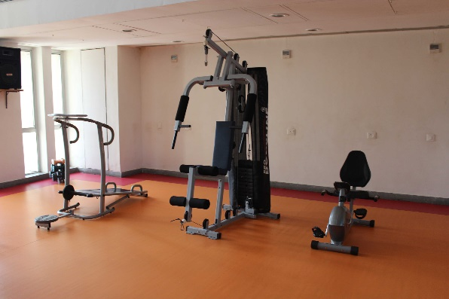

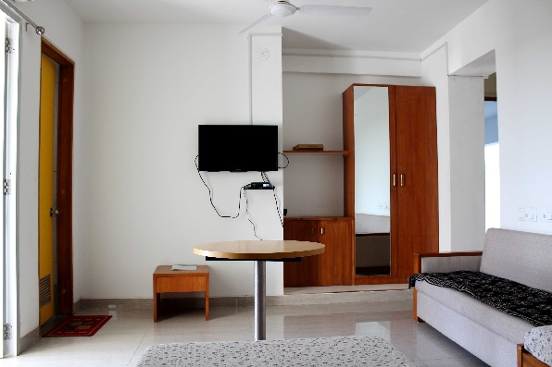
Physical Infrastructure

Slide 48
धन्यवाद
Thank You

Slide 49
PM-One Nation One Subscription
Service from: 2003(UGC-Infonet) , ONOS (2025)
6000 Cr (25-27) || 30 International Publishers

Slide 50
Background
UGC-INFONET Digital Library Consortium (December 2003)
Launched by
Dr APJ Abdul Kalam
Former President of India
  Funded by the MoE
  Access of e-Resources to CFTIs
UGC-INFONET Connetivity Programme (December 2002) Innagurated by
Shri Atal Bihari Vajpayee
Former Prime Minister of India
2004
INDEST-AICTE
  Funded by the UGC (2004 – 2015)
  Access of e-Resources to Universities
2003
UGC-INFONET
2010
NLIST
  Funded by NMEICT 2010-13 & by UGC 2014-15
  Access of e-Resources to Colleges
2016
E-ShodhSindhu
Notes:
INDEST-AICTE (2004)
NLIST
(2010)
E-Shodh Sindhu (2016)

Slide 51
Background
eShodh Sindhu
DRDO
CeRA
ERMED
MCIT
NLIST
DeLCON
DAE
NKRC
All Other Govt. Colleges
Access to subscription journals were being acquired through different library consortia of government departments, academic and R & D institutions; and through individual subscriptions by various higher education and R & D institutions
E-Resource Consortium

Slide 52
Background
ONOS was first proposed in the country’s fifth draft National Science, Technology, and Innovation Policy (2020)
Approved by Union Cabinet on November 25, 2024
Implemented on January 1, 2025

Slide 53
One Nation One Subscription
Central Sector Scheme for Rs. 6000 Cr for three years (2025-27) National consortium for journal subscriptions
Subscription Journals
• Centrally negotiated and centrally funded national subscriptions for e-journals
• Access to every individual (who needs it) in the country
Article Processing Charges (APCs)
• Central fund (Rs. 150 Cr per year) for supporting APCs of selected good quality Open Access journals
• Discounts on APCs for Indian authors as far as possible

Slide 54
ONOS – Implementation
Phased implementation
i. Phase-1 (3 years) – Merge all library consortia and bring in more institutions
ii. Phase-II – include Private academic institutions through a public-private partnership model
iii. Phase-III – universal access – designated access points at public libraries

Slide 55
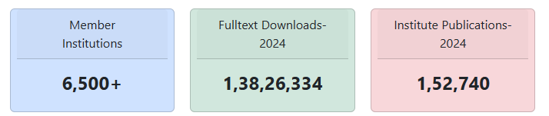
Member Institutions: 6500+
Institutions of National Importance (INIs) (including CFTIs under Department of Higher Education and INIs under other ministries)
Universities:
Central Universities
State Public Universities
IUCs of UGC
Deemed universities government/Govt aided
Government Colleges
Other MoE institutions (research Councils and research institutes receiving research grants from Research Councils)
Institutions under other Ministries & Departments

Slide 56
ONOS Registered Institutions Growth
Expected to Reach Targeted 6500 Institutions in next 3-4 months

Slide 57
Downloads by member institutions

Slide 58
List of Publishers
AAAS- Science
Elsevier ScienceDirect
ACM Digital Library
American Chemical Society
American Institute of Aeronautics and Astronautics
American Institute of Physics
American Physical Society
Annual Reviews
ASCE
ASME
Cambridge University Press
Cold Spring Harbor Laboratory Press
American Mathematical Society
American Society for Microbiology
Bentham Science
BMJ Journals
Emerald Publishing
ICE Publishing
IEEE
IndianJournals.com
Institute of Physics
Lippincott Williams & Wilkins (Wolters Kluwer)
Oxford University Press
Project Muse
Sage Publishing
SPIE Digital Library
Springer Nature
Taylor and Francis
Thieme
Wiley

Slide 59
Access Model
The different types of access modules under ONOS based on the existing infrastructure of the participating institutions are as under:
For Institutions who have their own static IP address for subscription to journal resources (example: University / Central Government Higher Education Institutions/ Research Institutions, etc.): For such institutions, access will be available through:
  Campus wide-Network: This means any computer /laptop/mobile device connected in Campus network will automatically get access to articles from all considered publishers. No separate individual user registration is required.
  Off-campus Access through INFED: using user Id and password through Shibboleth based Institute Identity Provider (IDP) authenticated by INFED Access Management Federation setup at INLIBNET Centre, Gandhinagar.
For Colleges & Institutions NOT having Static IP Address
  Centralized IDP setup at INFLIBNET using INFED is maintained by INFLIBNET Centre and institutional users managed by Librarian/nodal person of the Institute
  Authorised users from member Institutions are required to get their User ID and password from their respective colleges.

Slide 60






Access Methodology in ONOS
Select Institute Identity Provider
Use Single Sign On to Login
Authenticated & Allowed Access
Institute IDP
Campus IP Authenticated
Direct Access
Univ/CFTI/R&D Inst
ONOS Single Sign On to Login
Authenticated & Allowed Access
ONOS IDP
Librarian / Nodal Officer
Colleges
Create Login on ONOS IDP

Slide 61
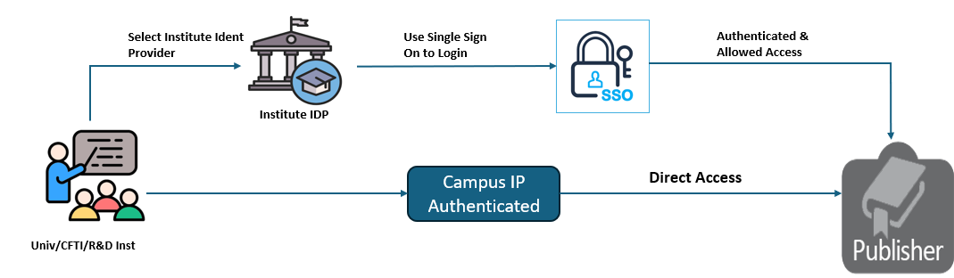
Access Model: Universities

Slide 62
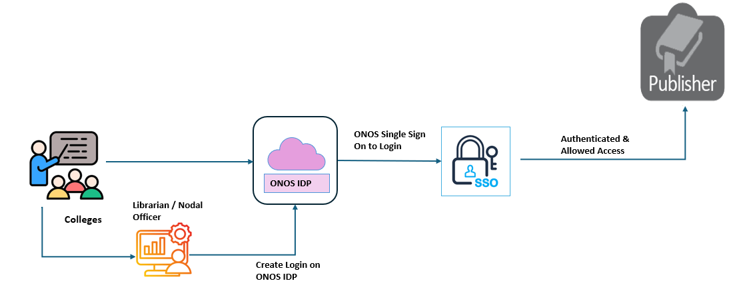
Access Model: College

Slide 63
  ONOS Portal

Slide 64
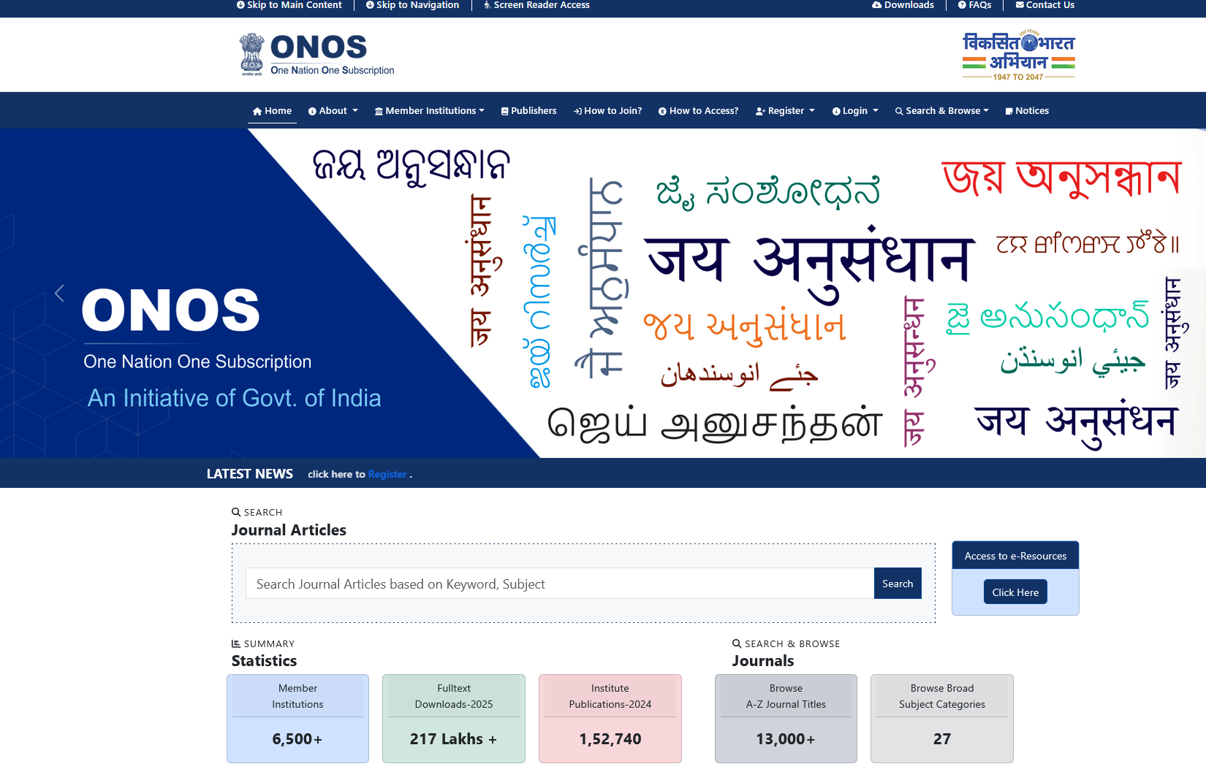
Platform
Member Participation
Publishers
How to Join
Journals
APC
User-Guide
Integrated ONOS portal for Users & Administrators
List of Institutions Registered & Dashboard
Publishers List subscribed under ONOS with number of journals
Registration for Institute & Users
Help manual for portal & access to e-Resources by Publishers

Slide 65


Platform
Member Participation
Publishers
How to Join
Journals
APC
User-Guide

Slide 66

Platform
Member Participation
Publishers
How to Join
Journals
APC
User-Guide

Slide 67

Platform
Member Participation
Publishers
How to Join
Journals
APC
User-Guide

Slide 68
Platform
Member Participation
Publishers
How to Join
Journals
APC
User-Guide
All Government (Central as well as state) HEIs and central government R & D institutions
Register at ONOS portal to get User ID and password.
  New registration will require institution name, AISHE code and contact details of institute nodal officer. Registered member institutions can be viewed at https://www.onos.gov.in/instituteList
  Institution AISHE Code is mandatory for registration. The institutions who do not have AISHE Code need to apply for AISHE code in the AISHE portal (https://aishe.gov.in/).
  Institutions engaged in research & development activities and not having students need to apply under the R & D category in the AISHE portal. For the R & D institutions, a letter authorising them to join ONOS from their parent Ministry / Department in the central government is necessary.
Existing government consortia users, including state government higher education institutions having their static IP address are being automatically ported to the ONOS portal for smooth transition

Slide 69

Platform
Member Participation
Publishers
How to Join
Journals / Articles
APC
User-Guide
ONOS Knowledge Finder (Gateway to Peer-reviewed Scholarly Content)

Slide 70

Platform
Member Participation
Publishers
How to Join
Journals / Articles
APC
User-Guide

Slide 71

Platform
Member Participation
Publishers
How to Join
Journals
APC
User-Guide

Slide 72

Platform
Member Participation
Publishers
How to Join
Journals
APC
User-Guide

Slide 73

Platform
Member Participation
Publishers
How to Join
Journals
APC
User-Guide

Slide 74
Terms & Conditions for Accessing ONOS Resources

Slide 75
License and Fair Use
Permitted Usage
Authorized Users from ONOS member institutions may access or use the Licensed Materials subscribed as per the following agreed terms:
Search, retrieve, display and view the Licensed Materials Electronically.
Download a digital copy, digitally save, digitally copy, and print a reasonable portion of the Licensed Materials. Licensee may charge a reasonable fee to recover costs of copying or printing portions of Licensed Materials for Authorized Users and such fees shall not constitute commercial use.
Provide single printed or electronic copies of single articles at the request of individual Authorized Users or a third party colleague for personal, scholarly, educational, scientific, or research uses (scholarly sharing).
Incorporate parts of the Licensed Materials in printed or electronic form in assignments and portfolios, theses and in dissertations which may include extraction and manipulation for the purpose of illustration, explanation, example, comment, criticism, teaching, research, and analysis with proper attribution to the publisher.
For scholarly citation, with appropriate credit, figures, tables, and brief excerpts with proper attribution to the publisher.
URL: https://www.onos.gov.in/license-fairuse

Slide 76
License and Fair Use
Restrictions
The Institution and Authorized Users are not allowed the following during the agreement as well as after termination of the agreement.
Commercial Use: sell or resell the Licensed Materials unless the Licensor has given the Licensee or an Authorized User permission in writing to do so. For the avoidance of doubt, research conducted by Licensee and Authorized Users that is supported by a commercial entity shall not be considered use for commercial purposes.
Remove Copyright Notice: remove, obscure or alter copyright notices, acknowledgements or other means of identification or disclaimers included in the Licensed Materials.
Modification of Licensed Materials: alter or adapt the Licensed Materials, except to the extent necessary to make it perceptible on a computer screen.
Display on Network: display or distribute any part of the Licensed Materials on any electronic network (including the internet) other than by a Secure Network.
Access to Unauthorized Users: knowingly or intentionally provide access and/or allow use of the Licensed Materials by anyone other than Authorized Users.
URL: https://www.onos.gov.in/license-fairuse

Slide 77

Remote Access
Indian Access Management Federation (INFED)
INFED provides user authentication and access control mechanism ensuring trust relationship between publisher, identity providing agency and the user institution.
Shibboleth
Off-campus Access to e-Resources
Institutes act as Identity Provider
Identity of users is concealed

Slide 78

Usage Monitoring

Slide 79


